Slide 1

Price Prediction Model AIRBNB dataset
DATA CLEANING
DATA VISUALIZATION
COMPARISION OF DIFFERENT ML MODELS
Submitted by :
Muskan
12214352
Submitted to :
Mr. Pramod Vishwakarma

Slide 2

About Airbnb
Airbnb is an online marketplace for arranging or offering lodging, primarily homestays, or tourism experiences since 2008. NYC is the most populous city in the United States and also one of the most popular tourism and business place in the world.
This dataset describes the listing activity and metrics in NYC, NY for 2019.
This data file includes all needed information to find out more about hosts, geographical availability, necessary metrics to make predictions and draw conclusions.

Slide 3
Columns of dataset
Id
Name
host_id
host_name
neighbourhood_group
Neighbourhood
Latitude
Longitude
room_type
Price
minimum_nights
number_of_reviews
last_review
reviews_per_month
calculated_host_listings_count
availability_365

Slide 4
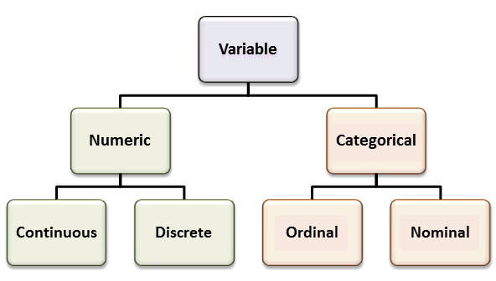
Descriptive Analysis of Data
Descriptive, which answers the question, “What happened? It is used to summarize and explore the behavior of the data involved in the study
Checking the variable types
These are divided into two types:
1.Numeric data - Continous data ,Discrete data
Columns are minimum nights, calculated_host_listings_count, price
2.Categorical data - Ordinal data ,Nominal data
Columnsare Neighbourhoodgroups,Neighbourhoods
Room types,Longitude,Latitude

Slide 5
Frequency Distribution`
The frequency distribution is an arrangement of values that one or more variables take in a sample. Each entry in the table contains the frequency or count of occurrences of values within a specific group or range, and so the table summarizes the distribution of the sample values.
The technique used to create the Percent column uses the following formula:
p -> Percent
Freq_x -> Frequency of an element x
Total freq-> Sum of all frequencies
p=100* freq_x/total freq
CONCLUSION FROM THE FREQUENCY DISTRIBUTION
Neighbourhood_group/Location
1° Manhattan -> 21661(44.30%) 2° Brooklyn -> 20104(41.11%) 3° Queens -> 5666(11.58%)
neighbourhood/Area
1° Williamsburg -> 3920(8.01%) 2° Bedford-Stuyvesant -> 3714(7.59%) 3° Harlem -> 2658(5.43%)
room_type/listing space type
1° Entire home/apt -> 25409(51.96%) 2° Private room -> 22326(45.66%) 3° Shared room -> 1160(2.37%)

Slide 6

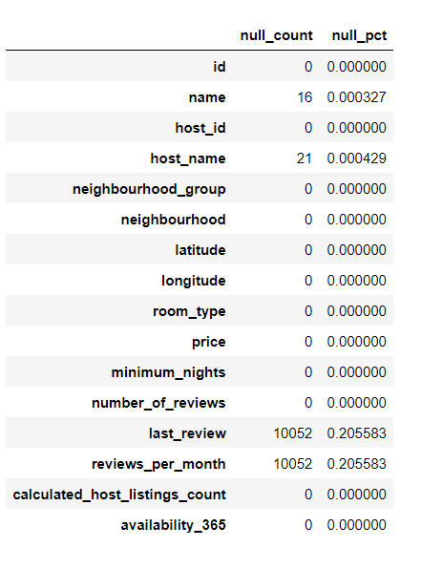
Data cleaning
Checking the NULL values
Dropping the Unnecessary columns that not help in the prediction
Eg. 'name','id','host_name','last_review'
Replacing the columns that are not having value with suitable values .
Eg. Replacing the Nan value with 0 in review per month
Removing where the price is equal to 0 as it is not possible.

Slide 7

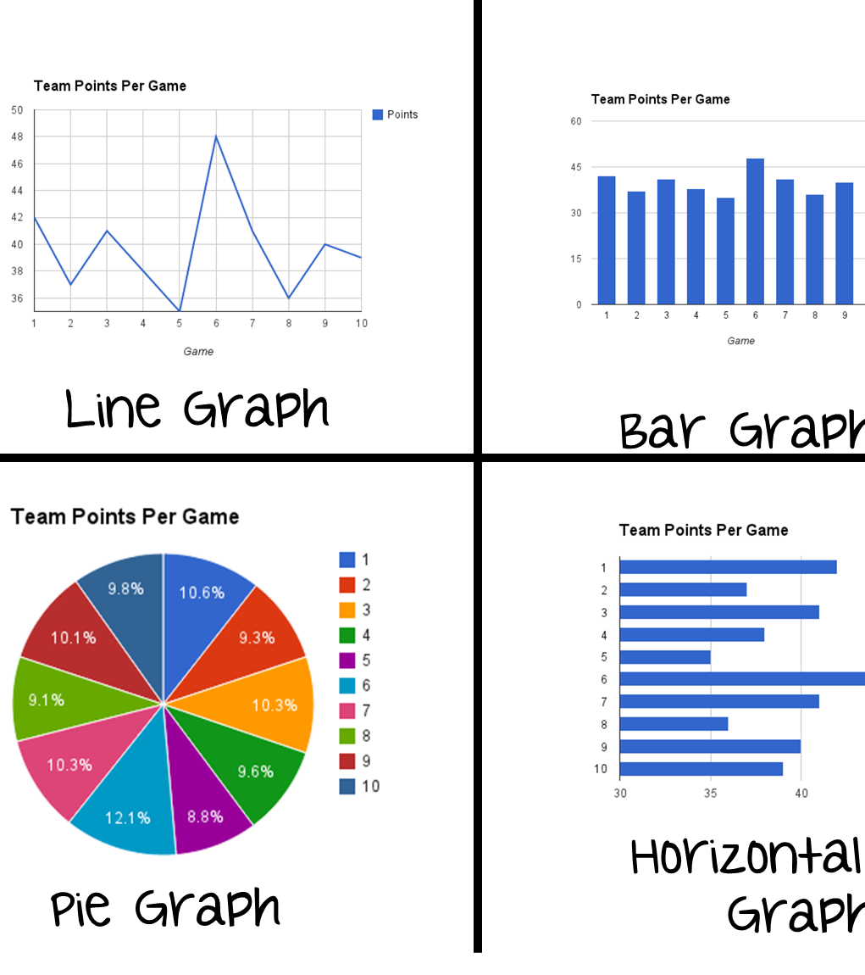
Data visualizations ​
This Photo by Unknown author is licensed under CC BY-NC-ND.

Slide 8
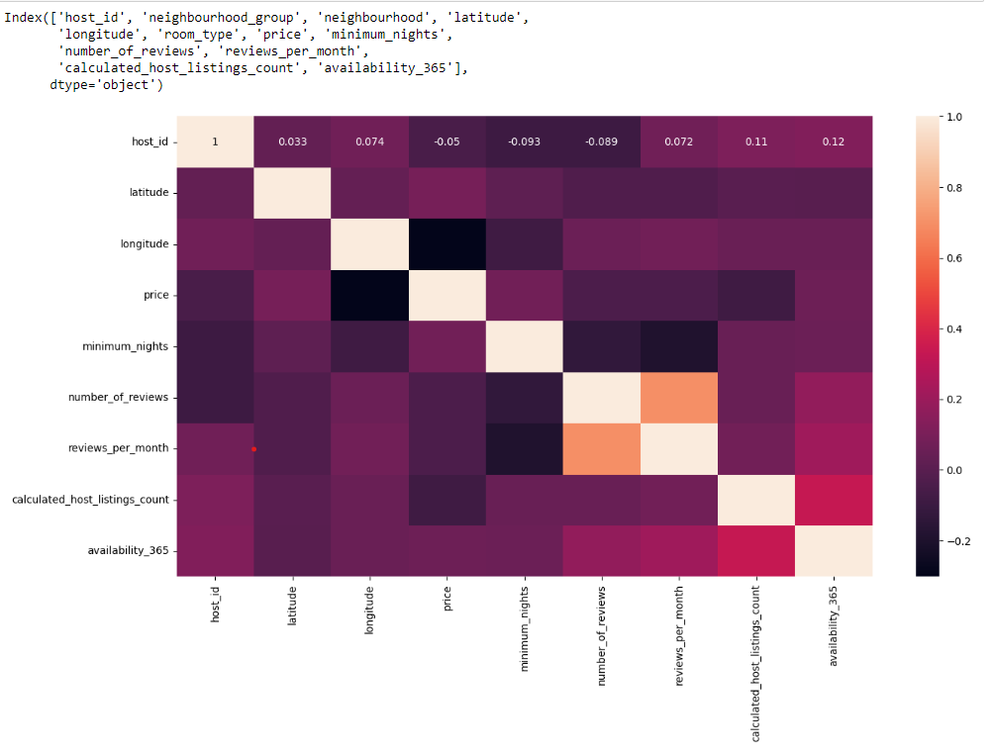
Heatmap
This heatmap is used to find the correlation of two different variables .Tells the degree of correlation that exists.The colorbar describe the intensity of correlation .1 is the max

Slide 9
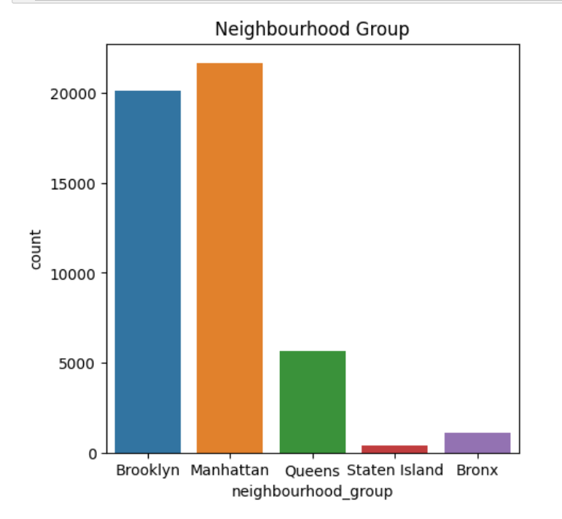
Neighbourhood group proportions
Tells the count of the hotels in the particular negihourbood group

Slide 10
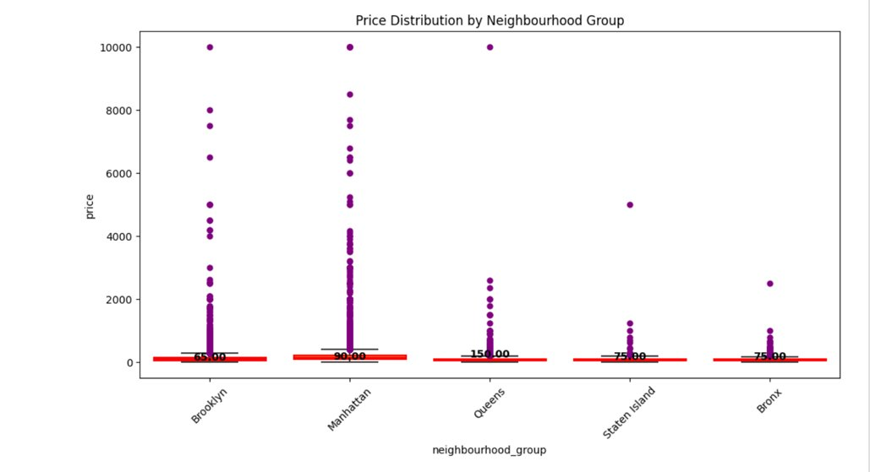
Relation of price with the neighbourhood group
Tells the overall distrbiution of the price according to the property in their particular neighourhood

Slide 11
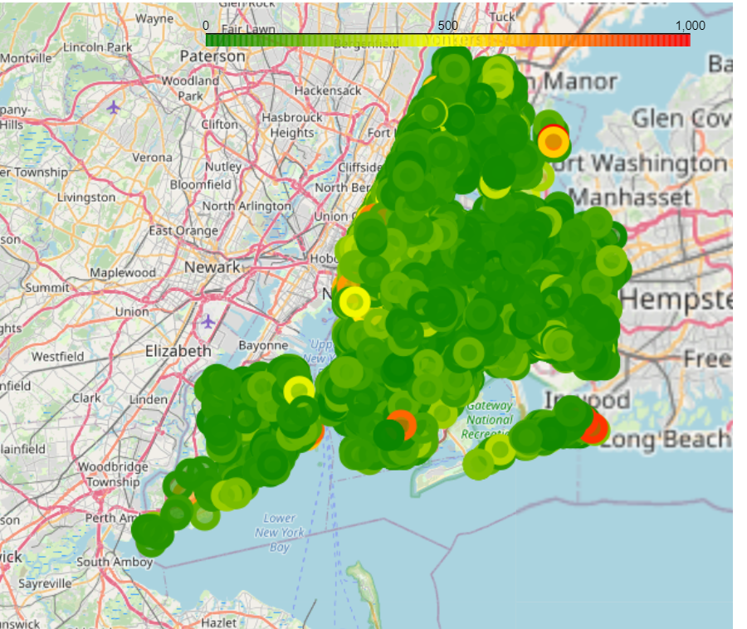
FOLIUM MAP Map tells the relationship between the price according to the neighourhood group w.r.t to the latitude and the longitude . Colorbar tells the price range of the price in this case it is filtered to 1-1000 dollar Help in getting the data by filtering it Observations can be made like which is best suited place which is high price area etc

Slide 12
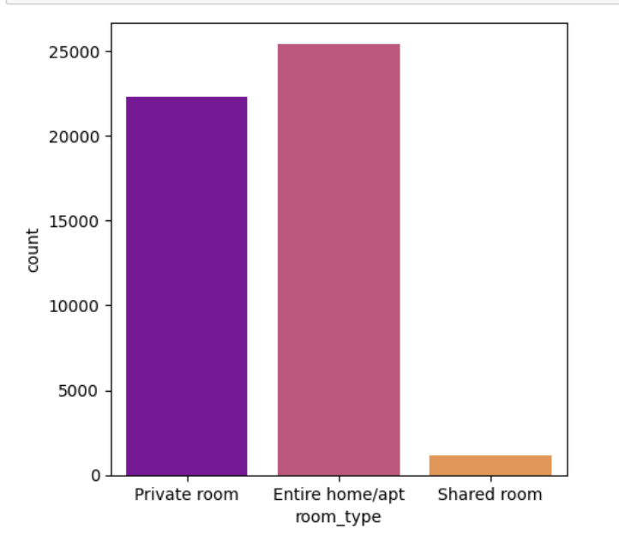
Price vs Room type
Helps to tells the proportion of the room .
Tells which room type to prefer

Slide 13
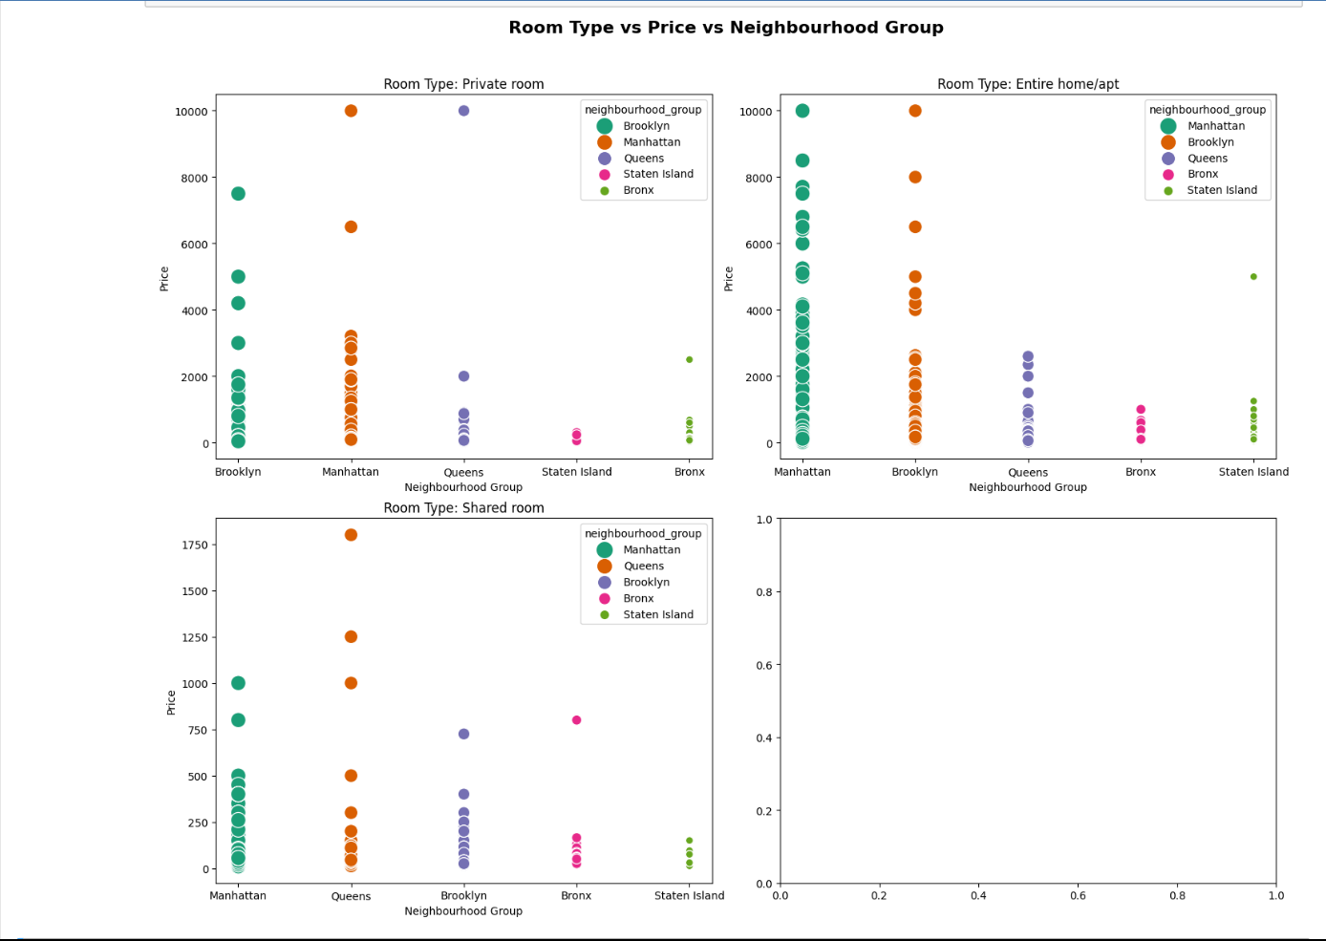
Price vs Room type vs Neighbourhood group
All the neighourhood groups are divided w.r.t to the room type
Helps in easy visualization that which type of property are famous in which area

Slide 14
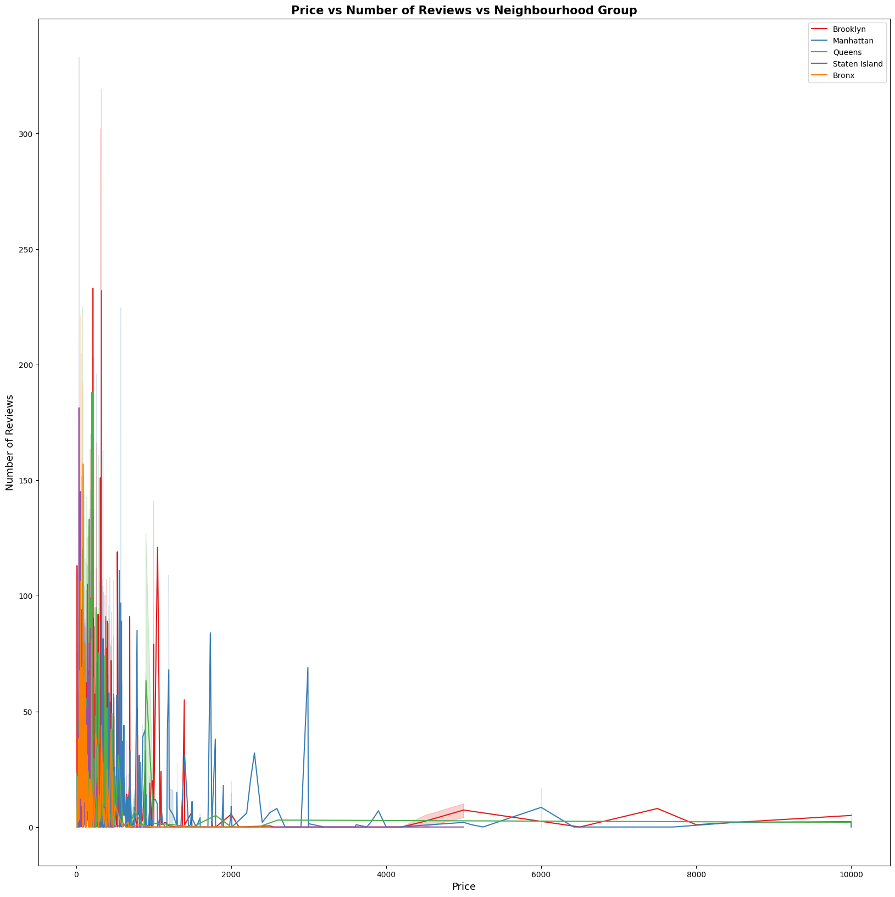
Price vs Number of Review vs Neighbourhood groups
Observation the house with more number of review is having less price .
Negative correlation between the review and price

Slide 15
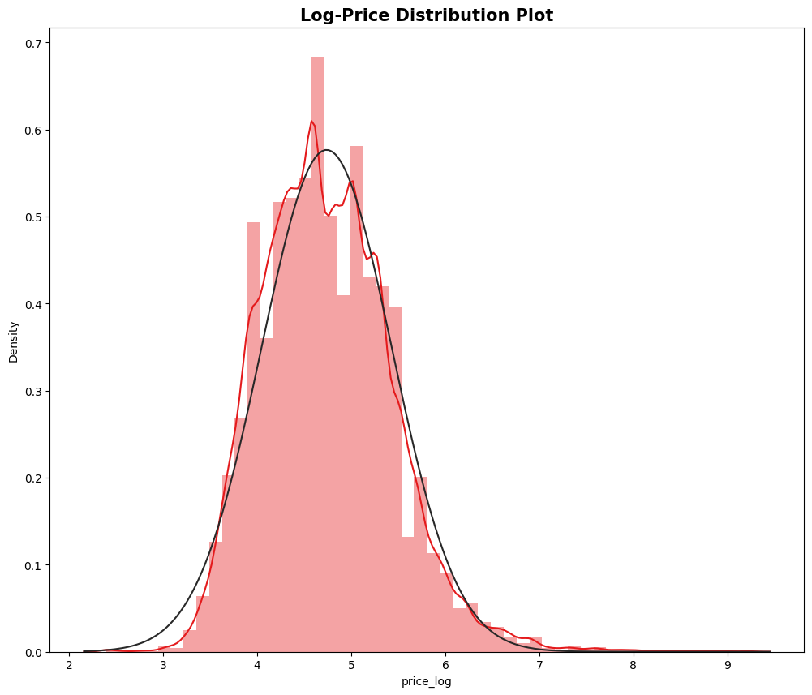
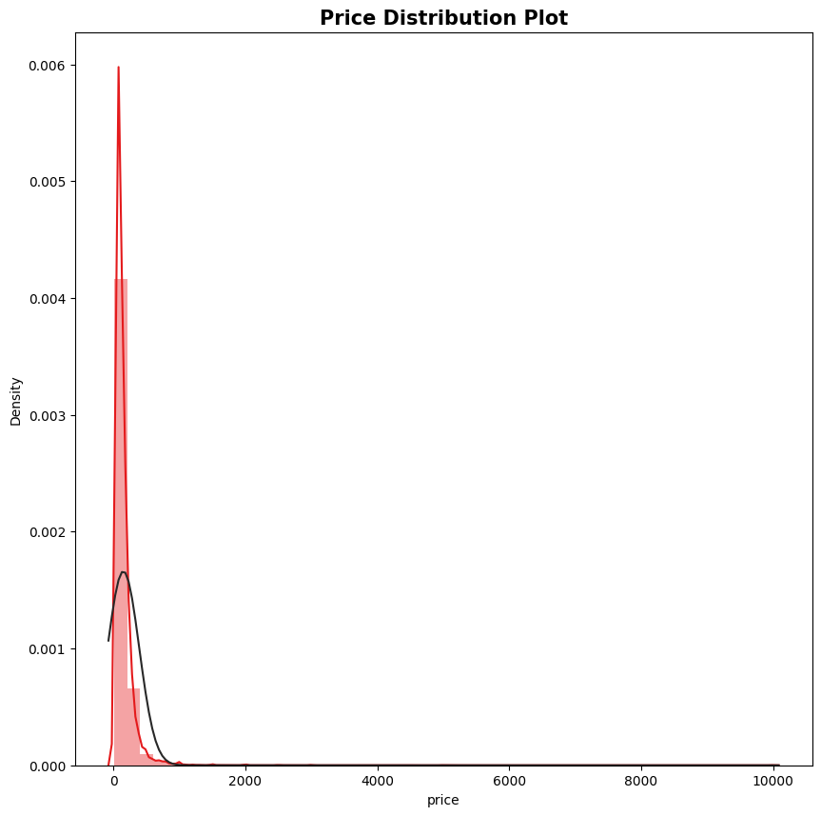
Price distribution graph
Price is having positive skewed graph so for better results we will do the logarithmic transformations converting the price into price_log that helps to give us normal distribution

Slide 16
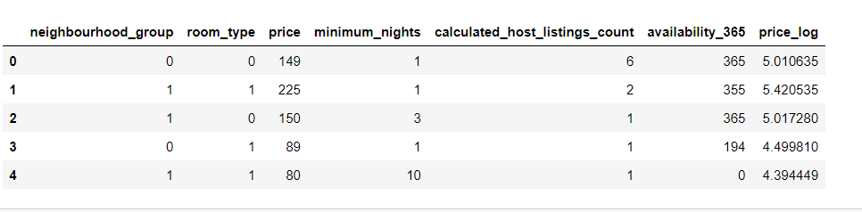
Encoding the data
Converting the categorical data into numerical data so that the variable can be used in the model.Eg. Conversion of the room type and neighbourhood group into numbers

Slide 17

Machine learning algorithms
Linear Regression
Lasso Regression
Decision Tree Regression
Ridge Regression

Slide 18
OBSERVATIONS on the basis of:
R Squared score : R² indicates the proportion of variance in a dependent variable explained by an independent variable.
RMSE :Root Mean Square Error measures the typical prediction error's magnitude
MAE : Mean absolute error indicates the proportion of variance in a dependent variable explained by an independent variable.
ACTUAL VS PREDICTED VALUES

Slide 19
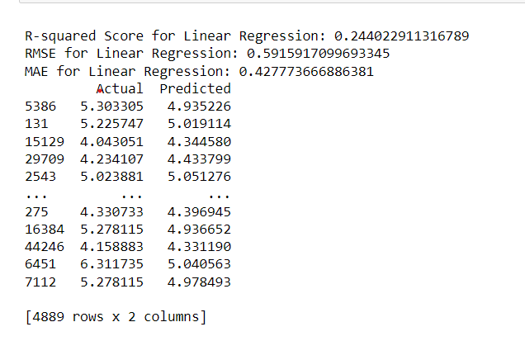
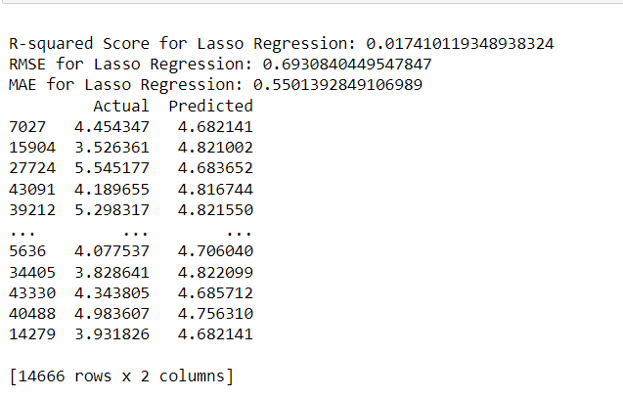
Linear Regression
Lasso
Regression

Slide 20
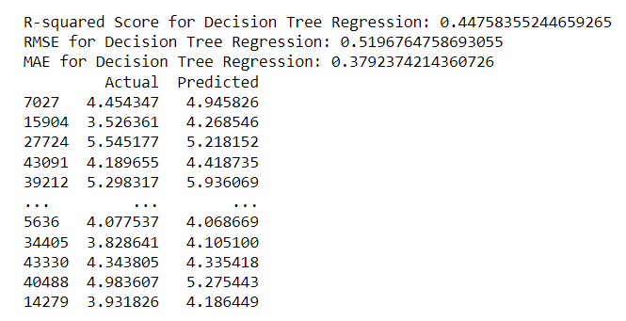
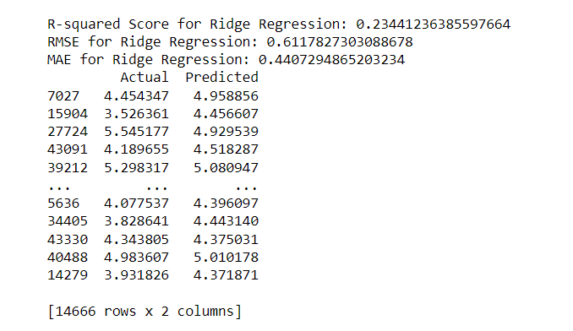
Decision Tree Regression
Ridge
Regression
**Note that the predicted value and actual value is Price_log

Slide 21
Thank you

